Slide 1
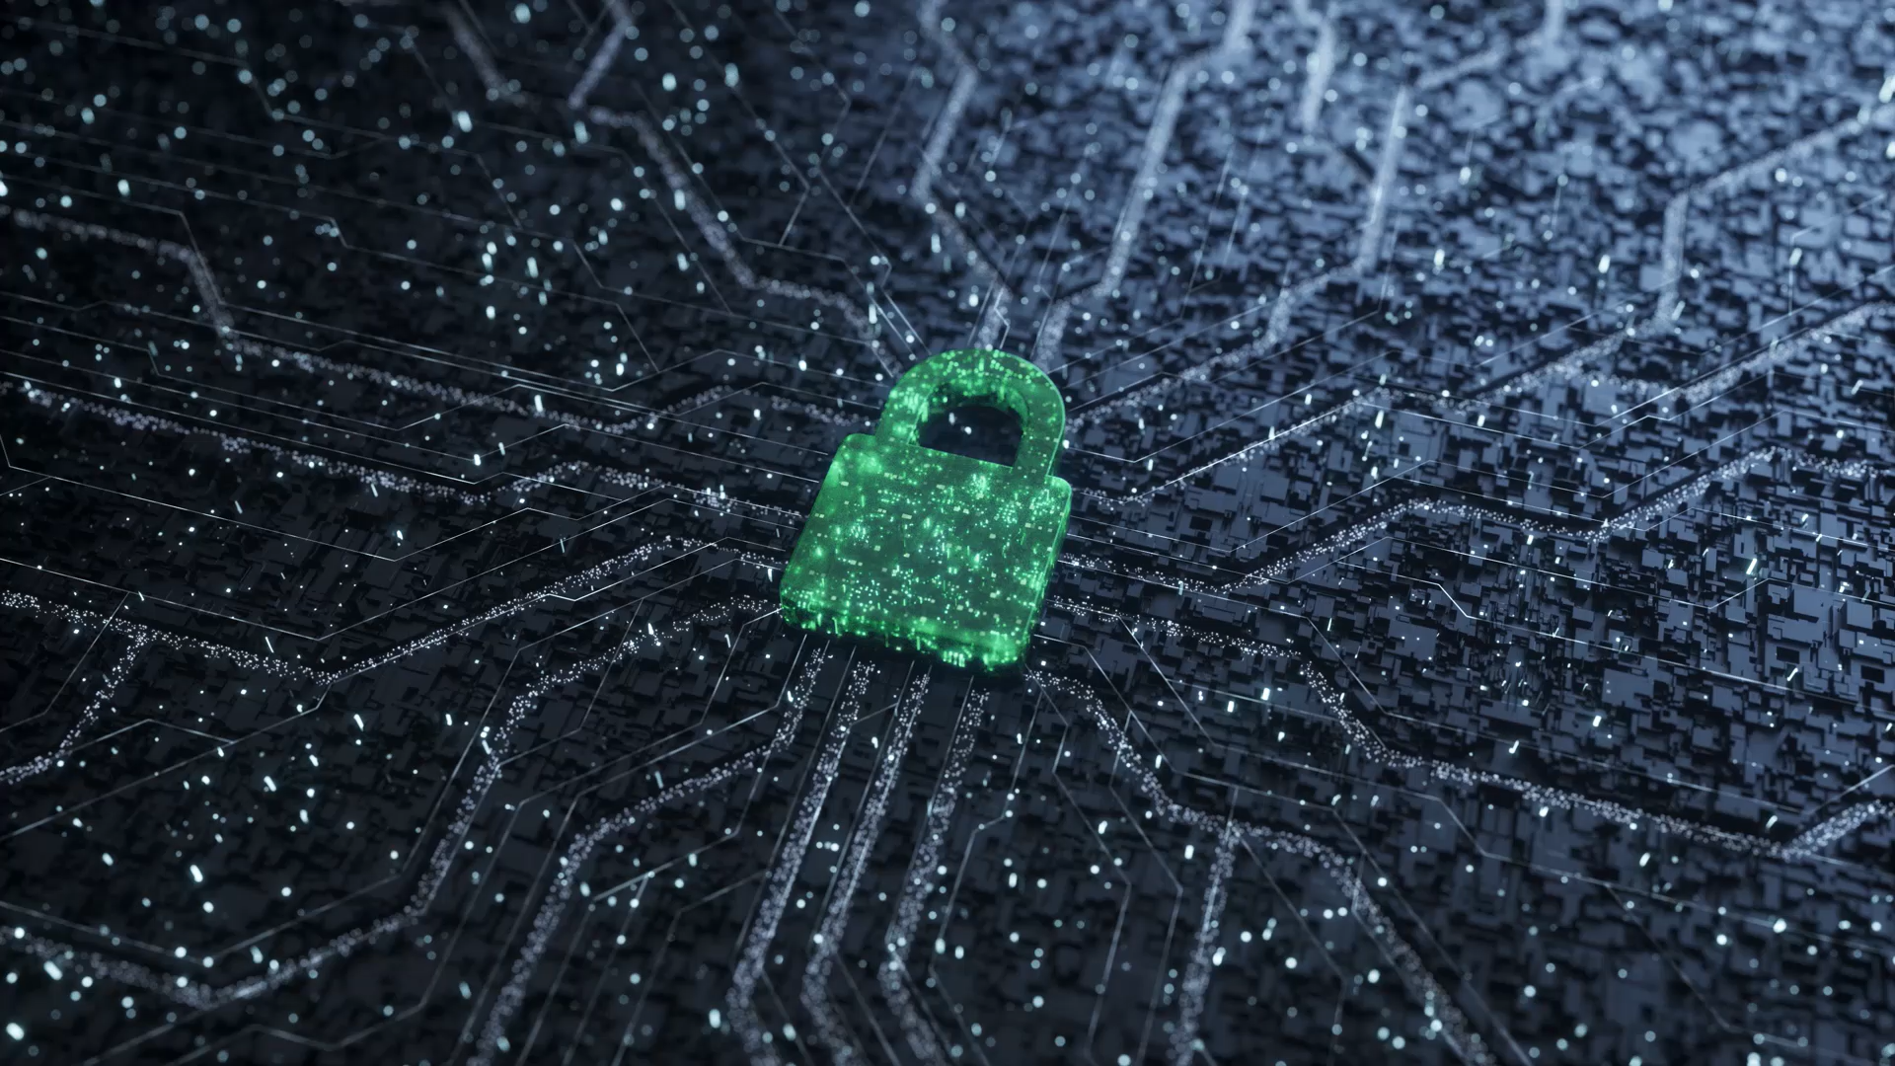
Secure Digital Investigation System
A Secure, Structured and Tamper-Proof Evidence Management Platform

Slide 2

The Problem: Missing & Lost Dockets
-Physical dockets get lost, misplaced, or damaged
-Case information becomes incomplete or inaccessible
-Investigations are delayed or abandoned
-No reliable tracking of case movement

Slide 3
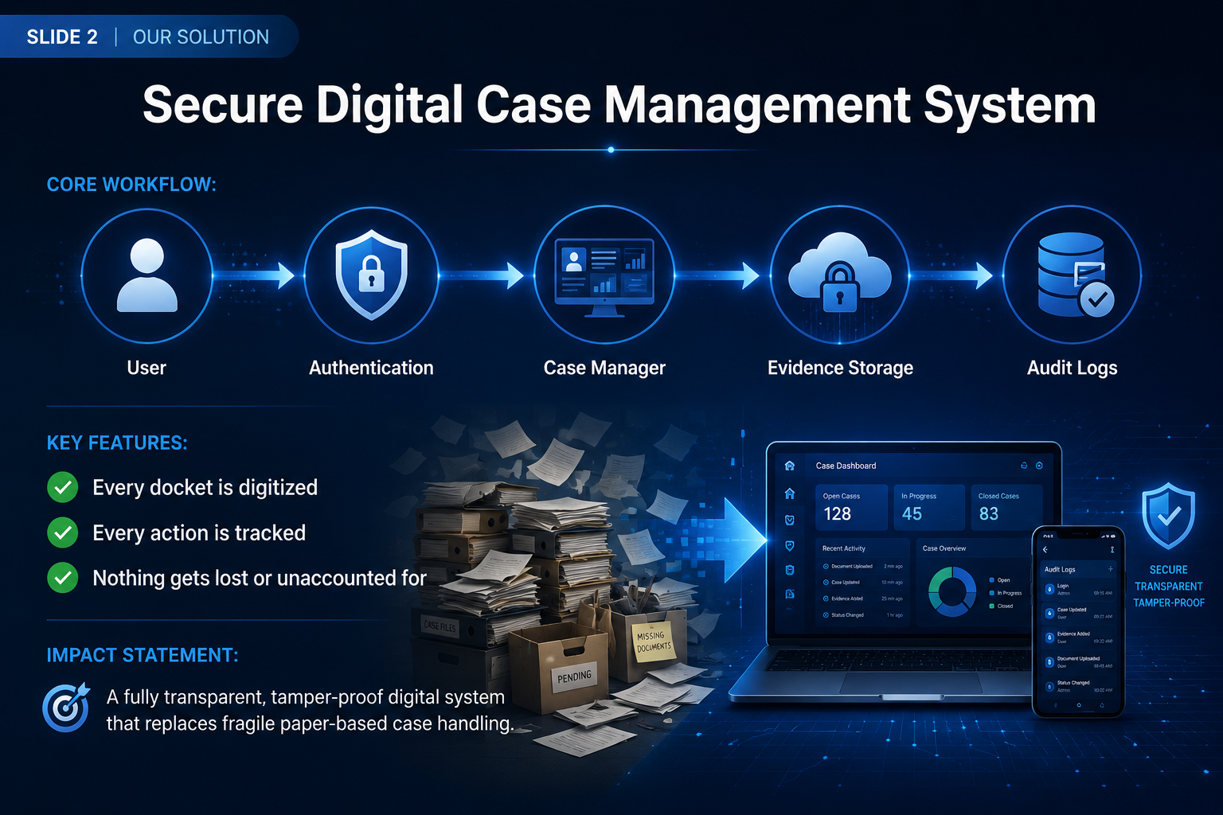

Slide 4
How We Eliminate Lost Dockets
-Each case gets a unique ID
-All evidence is linked to that ID
-Automatic audit logging
-Centralized digital storage

Slide 5
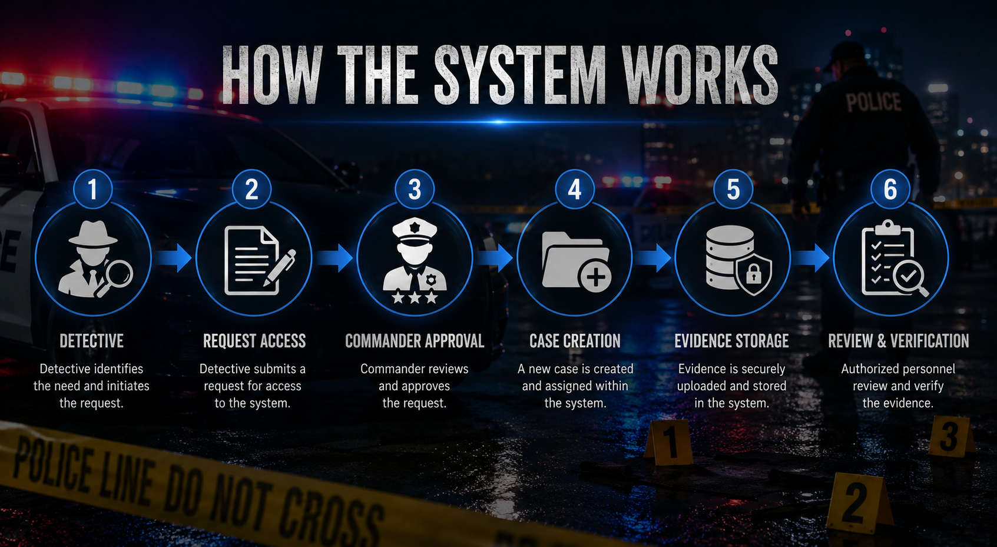

Slide 6

Security & Access Control
-Prevents unauthorized access.
-Validates every user login.
- Multi-layer access control system .
-Only verified users can modify data
- Logs record every action permanently
-Evidence cannot be secretly modified
- Full transparency of all case activity

Slide 7
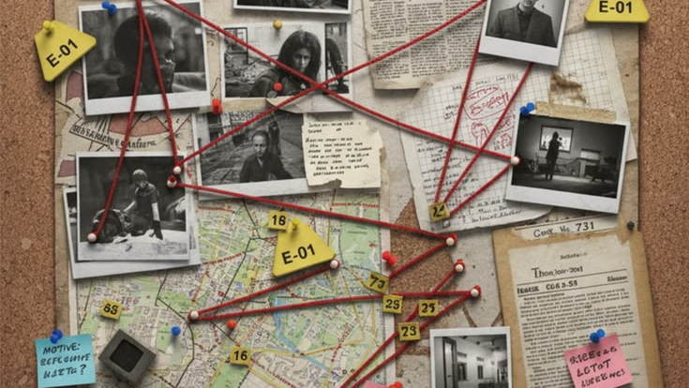
CONCLUSION
Impact on Justice System
Impact:
No more lost or missing dockets
Faster investigations
Stronger case integrity
Improved trust in record keeping
Future:
Database integration
Cloud backup
Encryption of evidence
Multi-agency access

Slide 8
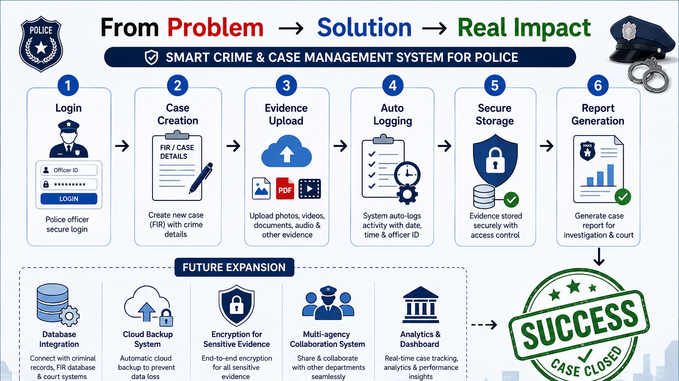

Slide 9
Thank you for your time and consideration.
We believe this system is a step forward in modernizing criminal case management and strengthening trust in justice systems.
We Leave You With a future where:
No docket is ever lost
Every case is fully traceable
Justice is faster, safer, and more reliable
Secure today. Justice tomorrow!!
Project Video Submission
Please click this link below to watch our video presentation/project pitch:
https://drive.google.com/file/d/1B-mX4U-uHA9Uz5xcgFfu9EpBDtl5Lojx/view?usp=sharing

